Slide 1
ELEC5566M FPGA Design for System-on-Chip
Mini-Project
Unit 3.1
Prof Steven Freear Module Leader s.freear@leeds.ac.uk
Dr David Cowell

Slide 2
Units 2-3: Mini-Project
What? Open brief “Interactive LCD based FPGA demonstrator”
Where? Minerva» ELEC5566M» Assessment & Feedback » Assessment 2 – Units 2-3: Mini-Project
Deadline Code and report 2nd May 2024 at 2:00 pm Viva within May/June Exam Period - Date to be confirmed by exams office. You must FINISH before the deadline. No extensions – Don’t wait until the last moment!
Groups Working in groups of 4 (or exceptionally 3 or 5) Shared GitHub repositories will be provided for each group.

Slide 3
Technical Brief
Brief Program the DE1-SoC development board and LT24 LCD module
Create an interactive demonstration of your FPGA design skills you have learnt throughout this module.
You may choose to design a game, an educational device, a fractal generator, or other design of your choosing.

Slide 4
Groups
Working in groups of 4 (or exceptionally 3 or 5)
Split work into defined tasks for each team member
Choose own groups and notify via MS Form link on Minerva
Deadline for requesting group: 8th March 2024 at 2pm
Anyone not in a timely group request will be RANDOMLY allocated to a group!
Confirmation of groups expected to be on 11th March 2024
Individual working is only possible where considerations are already agreed with SSO.
Please contact d.m.j.cowell@leeds.ac.uk if you have agreed to work individually.

Slide 5
Open book? Plagiarism?
Open book – you can use your module notes
Any external IP must be referenced in code, report AND presentation
No plagiarism
No external help
No posting questions on websites
No collusion between groups or previous students
Any instance of cheating will be dealt with via standard university examination policies.

Slide 6
Requirements
Minimum requirements:
Use the LT24 LCD, or VGA output.
Make use of Buttons/Switches for inputs.
Make use of seven segment display
Build simple State Machine logic.
Testbench Simulation.
Well formatted, fully commented code, incrementally committed to GitHub.
Single group technical report with individually written sections uploaded to Turnitin.
In-person viva with short technical presentation.

Slide 7
Requirements
To get better marks:
Hierarchical design.
Complex and/or Multiple State Machines.
Reuse of IP developed in module.
Use of your own custom IP blocks
Self-verifying testbenches.
To get even better marks:
Developing fully parameterised and generalised custom IP blocks.
Make use of other peripherals on the DE1-SoC
Notes:
Choose your demo wisely to ensure that you demonstrate ALL the skills you have learnt in this module.
You will create a report outlining the details of the system and its design, with evidence of as much testing, both simulation and hardware, as is required to verify your design. The report and presentation will be assessed according to the rubric on the Minerva» ELEC5566M» Assessment» Mini-Project page.

Slide 8
Assignment Information
Code with Incremental GitHub Commit (30%)
Code must be incrementally committed to GitHub throughout your development and testing process.
Only uploading code towards the end of the development cycle is not acceptable.
Technical report (40%)
Four pages per team member, uploaded to Turnitin.
In-person Viva with Hardware Demonstration (30%)
5-minute presentation highlighting the key parts of the project and what you have learnt.
Additionally, your presentation must be uploaded to Minerva.
You MUST have a working demonstration of your Mini-Project.
Technical questions will be asked by two examiners which you are expected to answer.

Slide 9
Rubrics – Code – 30%
 | Criteria | Overall Weighting | Poor 0% to 40% | Marginal 40% to 50% | Adequate 50% to 60% | Good 60% to 70% | Very Good 70% to 80% | Excellent 80% to 100%
Code | Coding Style - Comments | 2.5% | No submission or Code not changed. | Insufficient or inaccurate use of comments. | Header and line comments present but detail could be improved. | Good use of header and line comments with a good level of detail. | Very good use of header and line comments with a very good level of detail and consistency where applicable. | Exemplary use of header and line comments with an according level of detail and appropriate structure.
(30.0%) | Coding Style - White space/Layout | 2.5% | No submission or Code not changed. | Some basic use of white space. | Evidence of some indenting for code structure styling. | Consistent code identing for readability. | Very good use of code indenting and style to demonstrate code structure. | Exemplary use of coding style and layout.
 | Functional Verilog Coding | 15.0% | Incomplete code without comments. | Incomplete code with pseudocode-like comments detailing unwritten code. Variable names not descriptive | Complete code with basic comments. Suitable variable name but no consistency in style. | Complete code with detailed comments. Suitable variable name and consistency in style. | Complete code, well commented, readable and structured. Variable names descriptive and consistent in style. | Elegant and sophisticated code, well commented, readable and structured. Use of advanced coding techniques. Exemplary use of variable names.
 | GitHub Commit Frequency | 5.0% | No submission or repository code not changed. | Single commit of new code. Any code committed/uploaded from the GitHub website (single or multiple uploads) | Multiple commits of new code in large changes. | Frequent incremental commits. | Frequent incremental commits split by topic/function/file. | Evidence of exemplary use of GitHub commits.
 | GitHub Messages | 2.5% | No submission. | Commit summary present but does not allow changes to be identified. | Commit summary allows changes to be identified but description is not present. | Commit summary allows changes to be identified but description is lacking in detail. | Detailed commit summary and descriptions putting changes into context. | Exemplary commit summary and descriptions putting changes into context, including descriptions of external code sources.
 | GitHub Readme | 2.5% | No submission or readme not changed. | Minor changes to existing readme. | Readme with basic description of files. | Readme contains description of files. | Readme with description of files and functions. | Exemplary readme detailing all aspects of driver use including examples of use.

Slide 10
Rubrics – Written Report – 40%
 | Criteria | Overall Weighting | Poor 0% to 40% | Marginal 40% to 50% | Adequate 50% to 60% | Good 60% to 70% | Very Good 70% to 80% | Excellent 80% to 100%
Written Report | Abstract & Introduction | 10.0% | Negligible abstract and introduction. | Very basic abstract and introduction; does not really set the work in context. | Reasonable abstract and introduction, but with some errors. | Abstract and introduction sets the work in context and describe key outcomes. | The abstract introduction shows insight and effectively sets the work in context. | The abstract and introduction show highly perceptive account of context rationale and key findings.
(40.0%) | Testbench Verification | 10.0% | No evidence of simulation. | Basic functional simulation of main module performed. | Good functional simulation performed of main module. | Basic simulation performed of all functions. Basic changes made as a result of testing. | Good simulation performed of all functions. Basic changes made as a result of testing. | Exhaustive simulation performed of all modules. Changes made to code as a result of testing.
 | Hardware Testing | 5.0% | Little or no evidence of hardware testing. | Basic visual observational testing performed. | Basic visual observational testing performed demonstrating of some operations. | Good visual observational testing performed demonstrating all operations. | Thorough visual observational testing performed demonstrating ALL operations. | Thorough visual observational testing performed demonstrating ALL operations AND additional tests proposed.
 | Discussion/analysis & Conclusions | 15.0% | Negligible or incorrect discussion/analysis. | Basic level of discussion of results. Various errors. Little analysis. Basic conclusions. | Reasonable discussion of results, with some errors. Analysis attempted and summarised in the Conclusions. | Competent technical explanation with reasonable analysis and analytical summary. | Very good, error-free technical discussion; competent analysis and summary. | Highly competent technical discussion; perceptive analysis and analytical summary.

Slide 11
Rubrics – Viva with Demo – 30%
 | Criteria | Overall Weighting | Poor 0% to 40% | Marginal 40% to 50% | Adequate 50% to 60% | Good 60% to 70% | Very Good 70% to 80% | Excellent 80% to 100%
Viva (with Demo) | Introducing the project aims, background, and progress | 10.0% | No attempt to introduce the project aims or set the work in any context. No progress mentioned. | A basic introduction, but not effective in setting the context for the project. Very little indication of progress. | A reasonable attempt to introduce the project aims, but lacking in background information/context. Some mention of progress. | The project was introduced well, with some relevant comments on background and motivation, and also progress made. | The project was clearly introduced with a very good summary of background and motivation, and progress made. | A highly perceptive introduction, with a very analytical summary of background, and motivation. An excellent overview of progress made.
(30.0%) | Technical Content (of project work described) | 10.0% | No meaningful description of project work, and no meaningful conclusions. | Only basic project work is described, with no critical analysis, or useful conclusions. | Some project work is described, but lacking in depth, with little critical analysis or conclusions. | Some reasonable technical project work is described, with some critical analysis applied, and useful conclusions. | Comprehensive technical project work is described, with good critical analysis and synthesis demonstrated. Clear and useful conclusions. | Very comprehensive and competent technical project work is described, with excellent critical analysis and synthesis demonstrated. Very clear and insightful conclusions.
 | Response to Questions | 10.0% | Very poor. Demonstrated no real understanding of the project topic. No achievements were discussed. | Demonstrated very little understanding of the project topic, and almost no meaningful achievement | Demonstrated only a basic understanding of the project topic, and a minimal level of achievement. | Demonstrated a reasonable understanding in some areas of the project topic, and a good level of achievement. | Demonstrated a very good level of understanding in most areas of the project topic, and a comprehensive achievement. | Demonstrated a deep understanding of the project topic, and an outstanding achievement.

Slide 12
Questions

Slide 13
Unit 2.2 Task Recap

Slide 14
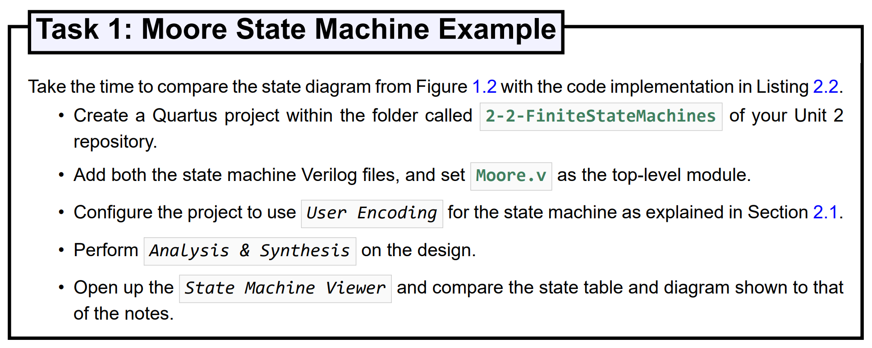
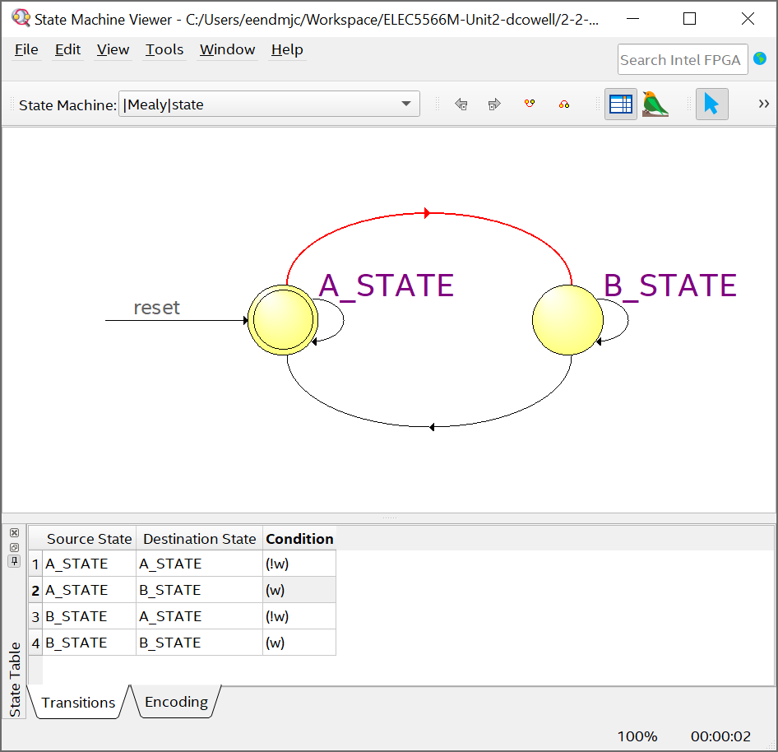
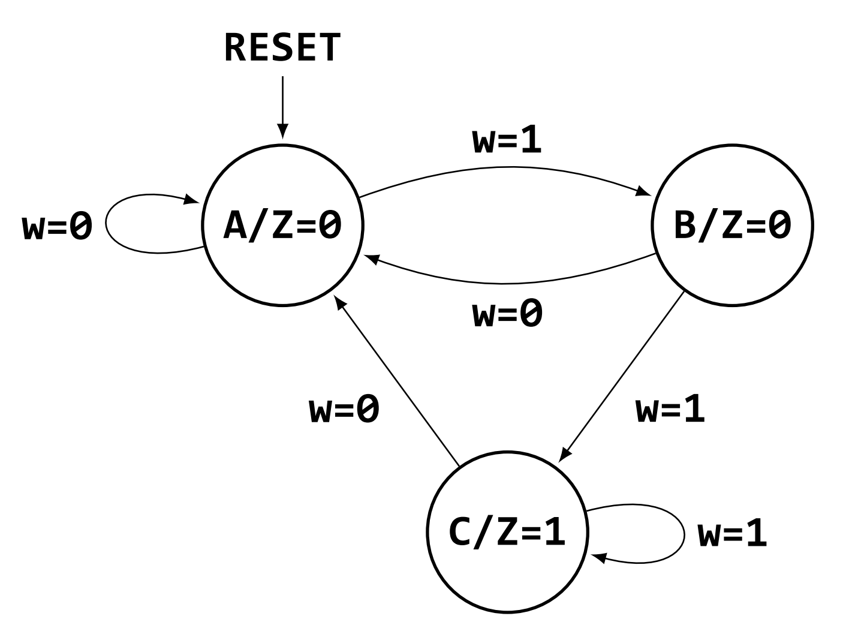
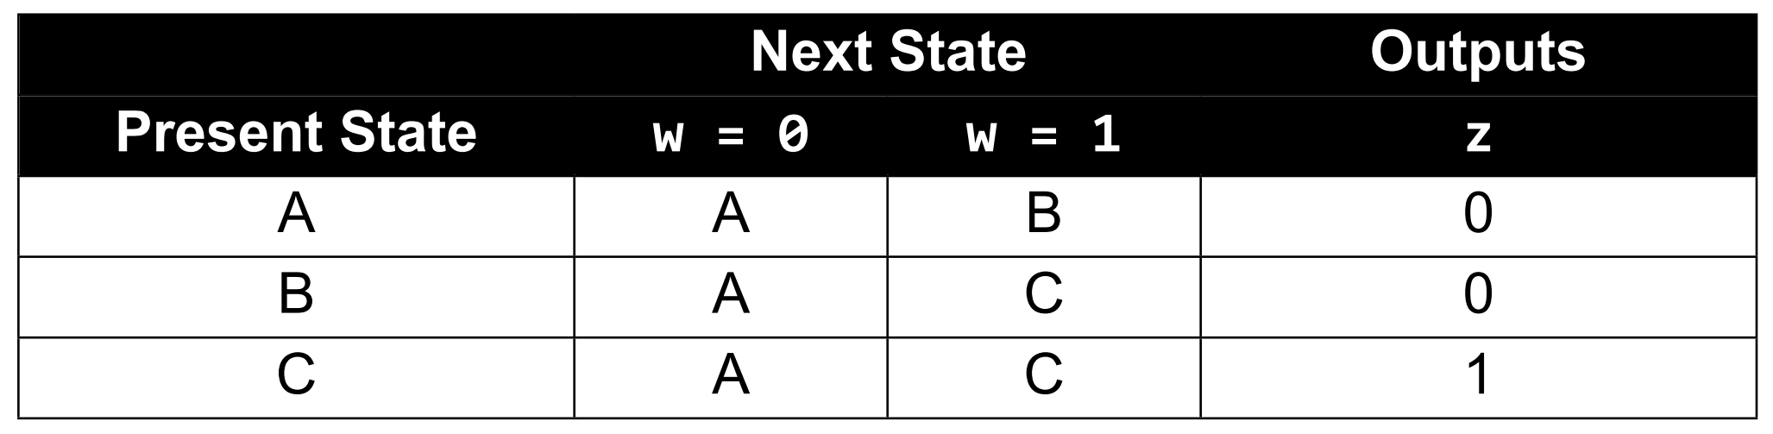
Task 1 – Moore State Machine
Clicking a state or condition
State Table or Diagram
highlights in both State Table and Diagram

Slide 15
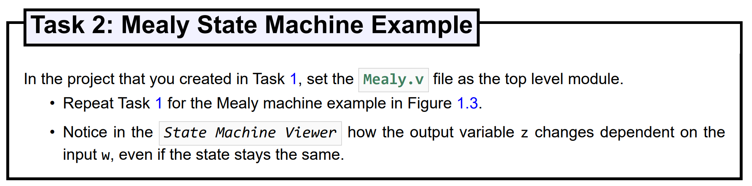
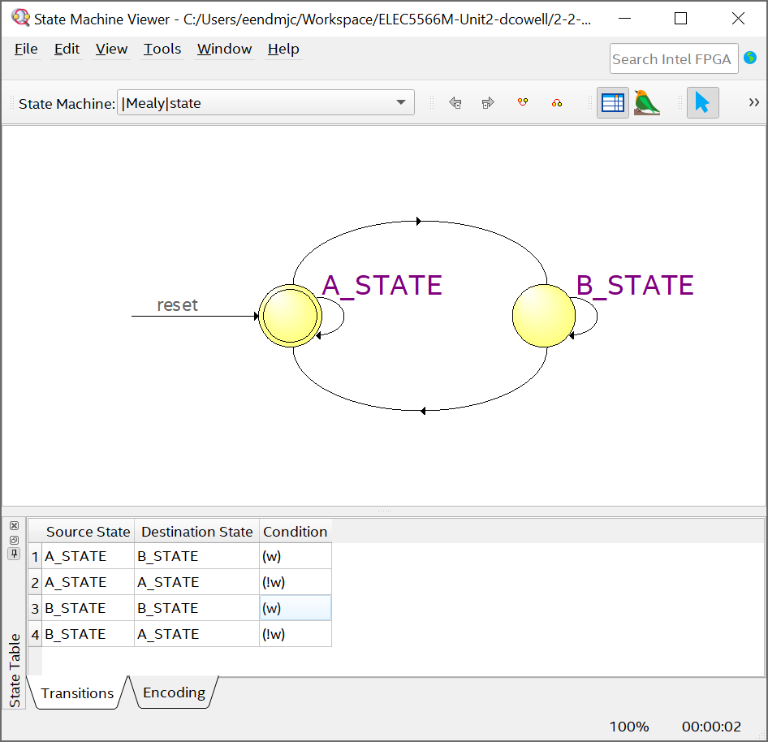
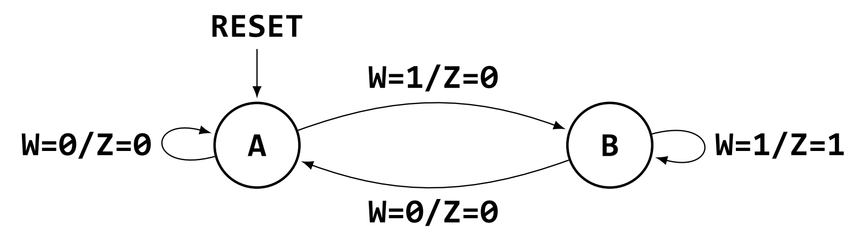
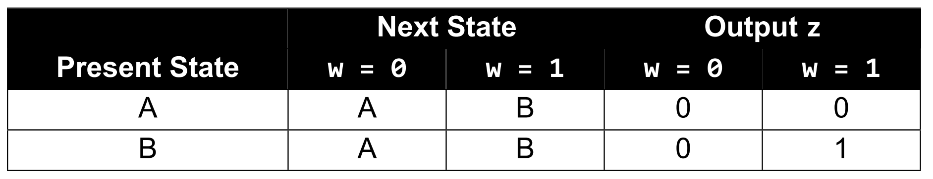
Task 2 – Mealy State Machine
Apologies – This is no longer shown in the State Machine Viewer in this Quartus Version!

Slide 16
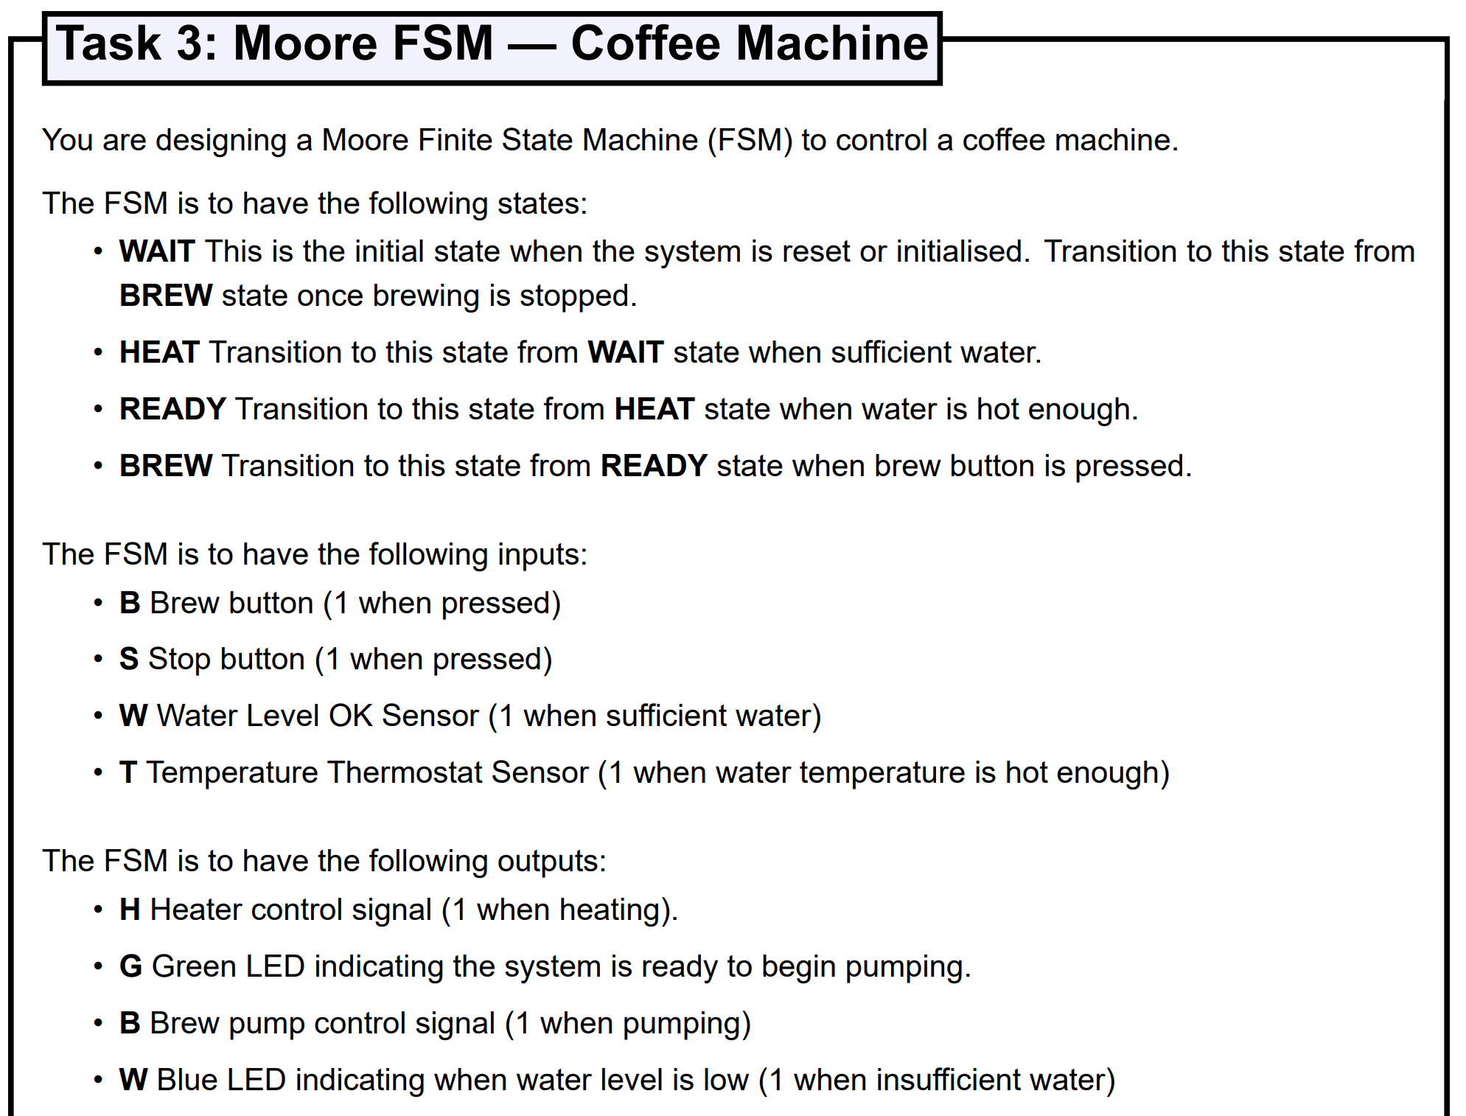
Task 3 – Coffee Machine FSM - Moore
 | Inputs define Next State |  |  |  | Present State defines Outputs
Present State | Brew Button B | Stop Button S | Water Level W | Thermostat T | Heater H | Ready LED G | Brew Pump B | Water Level Low LED W
WAIT |  |  | HEAT |  |  |  |  | 1
HEAT |  |  |  | READY | 1
READY | BREW |  |  |  |  | 1
BREW | WAIT |  |  |  |  |  | 1

Slide 17
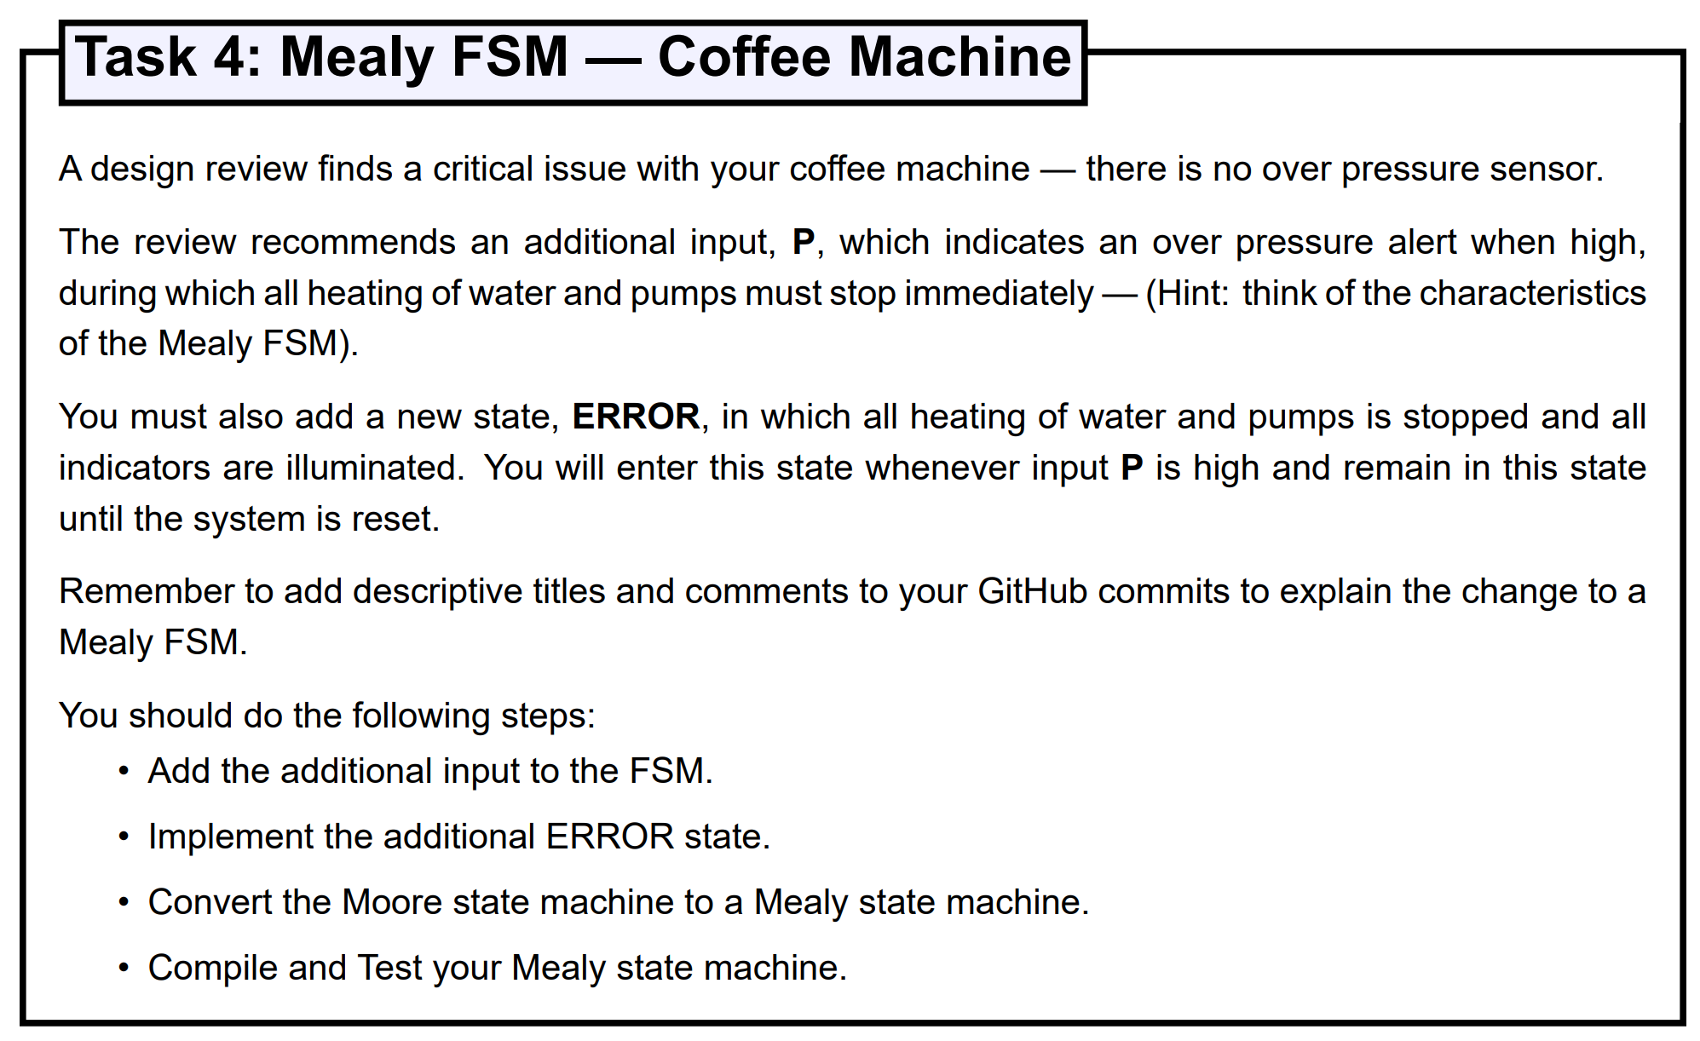
Task 4 – Coffee Machine FSM - Mealy
 | Inputs define Next State |  |  |  |  | Present State & Inputs defines Outputs
Present State | Brew Button B | Stop Button S | Water Level W | Thermostat T | Over Pressure P | Heater H |  | Ready LED G | Brew Pump B |  | Water Level Low LED W
 |  |  |  |  |  | (!P) P=0 | (P) P=1 | Don’t Care | (!P) P=0 | (P) P=1 | Don’t Care
WAIT |  |  | HEAT |  | ERROR |  | 0 |  |  | 0 | 1
HEAT |  |  |  | READY | ERROR | 1 | 0 |  |  | 0
READY | BREW |  |  |  | ERROR |  | 0 | 1 |  | 0
BREW | WAIT |  |  |  | ERROR |  | 0 |  | 1 | 0
ERROR | ERROR | ERROR | ERROR | ERROR | ERROR | 0 | 0 | 1 | 0 | 0 | 1

Slide 18
Unit 2.2
DE1-SoC Introduction
Compilation for Hardware
Number Representation

Slide 19
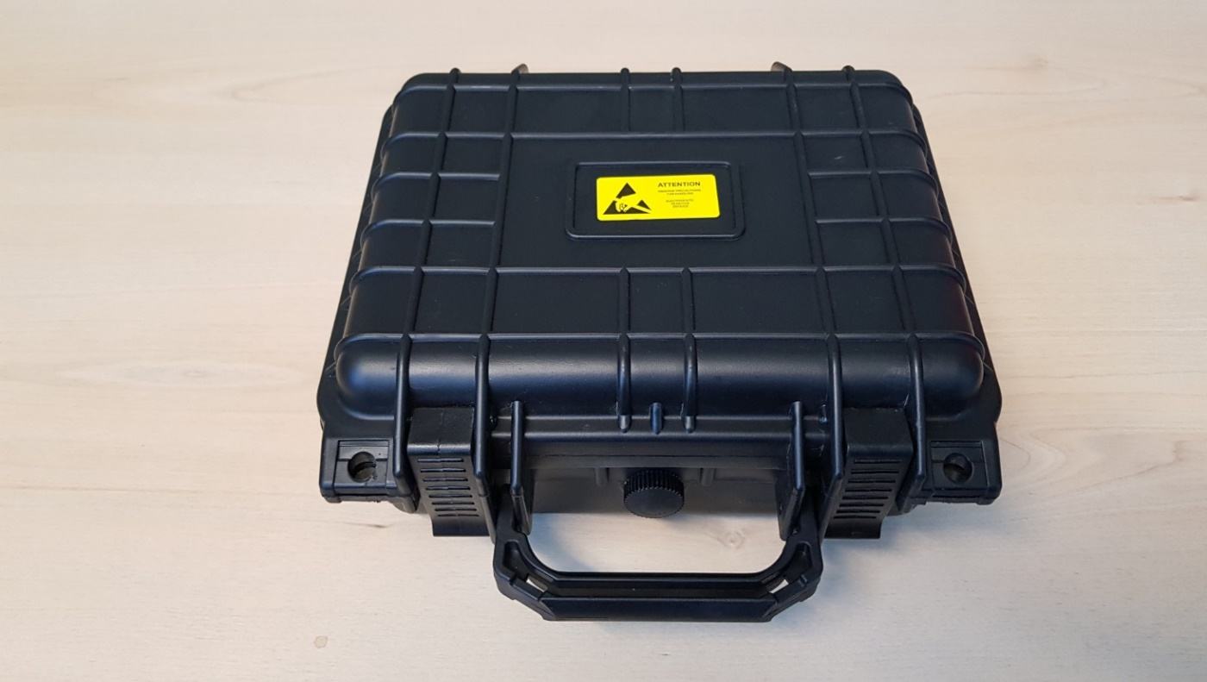
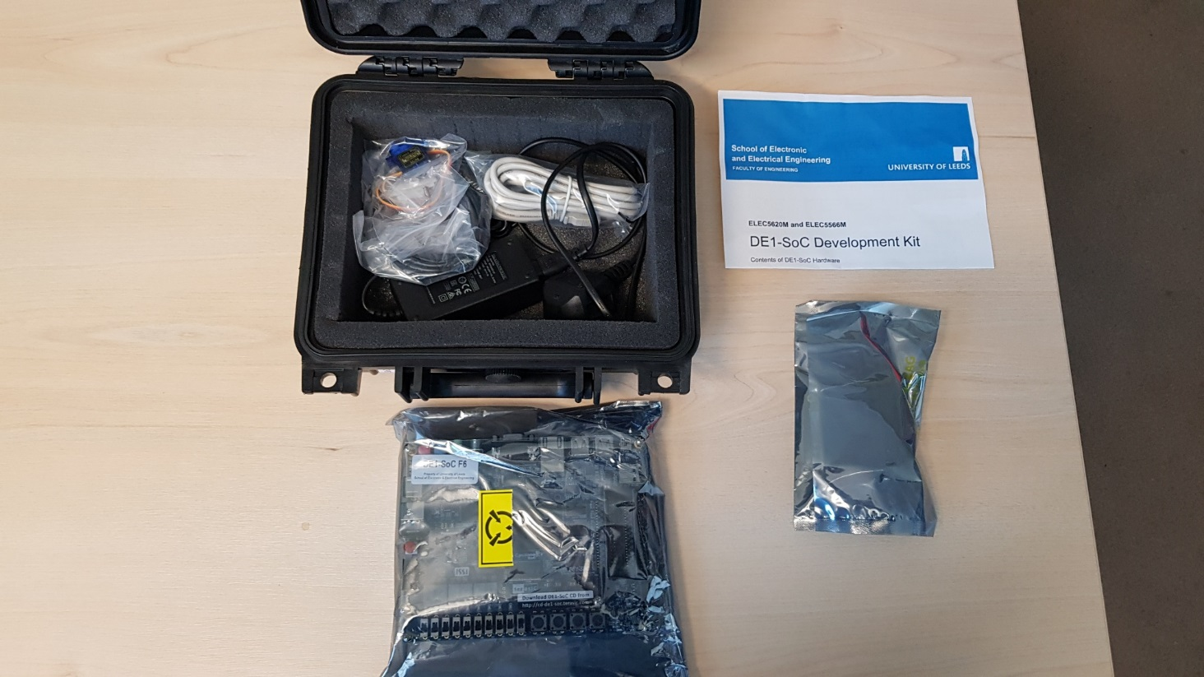
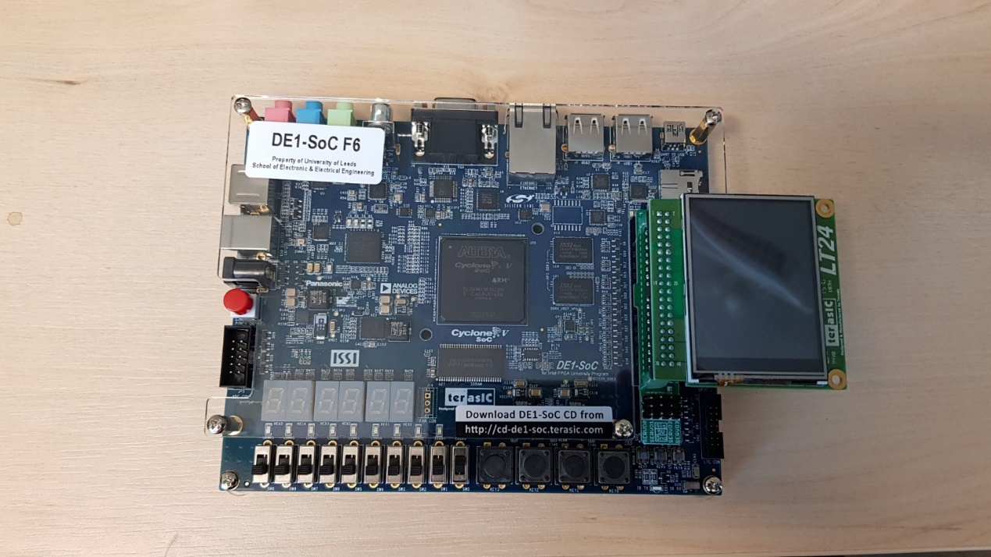
DE1-SoC Hardware
Each student is loaned a DE1-SoC Kit
Expensive system ~£250 (2024: £315 + £54 + £10 + £3 +£2 = £384)
You cannot graduate until your DE1-SoC and accessories are returned!
Can be used for projects after the module with prior agreement.
Do not dispose of the packaging material. Use it when returning kit.
Take ESD precautions. Do NOT touch exposed connections.
Take care plugging in LCD. Check alignment.
Notes:
ELEC5566M Lab 4

Slide 20
DE1-SoC Hardware Health and Safety Rules!
DO NOT leave DE1-SoC hardware unattended if plugged in to AC power supply.
Always use the supplied power supply lead (C8).
Always check the power cable for damage before use.
Always operate hardware on a non-flammable work surface.
Do NOT use the metallic ESD bags as a work surface – they are electrically conductive.
DO NOT cover hardware – no paper, clothes etc.
DO NOT have liquids or food near hardware.
If ANY problem, unplug from AC power supply and computer, then report to module leader.

Slide 21
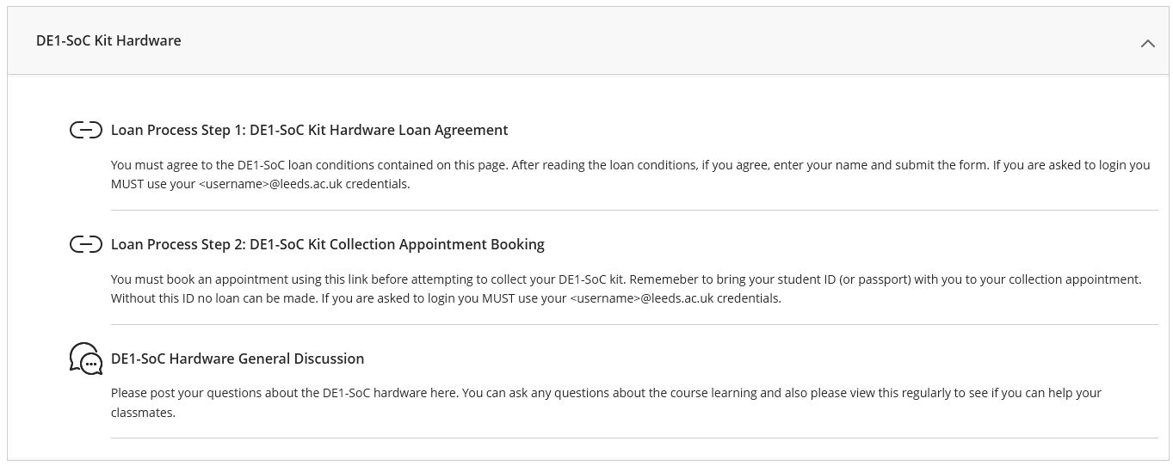
Hardware Loan

Slide 22

Hardware Loan

Slide 23

Hardware Loan

Slide 24

Hardware Loan

Slide 25

Hardware Loan Step 2 – Collecting during surgery on 7th March, 3-5pm, Elec. Eng 160

Slide 26
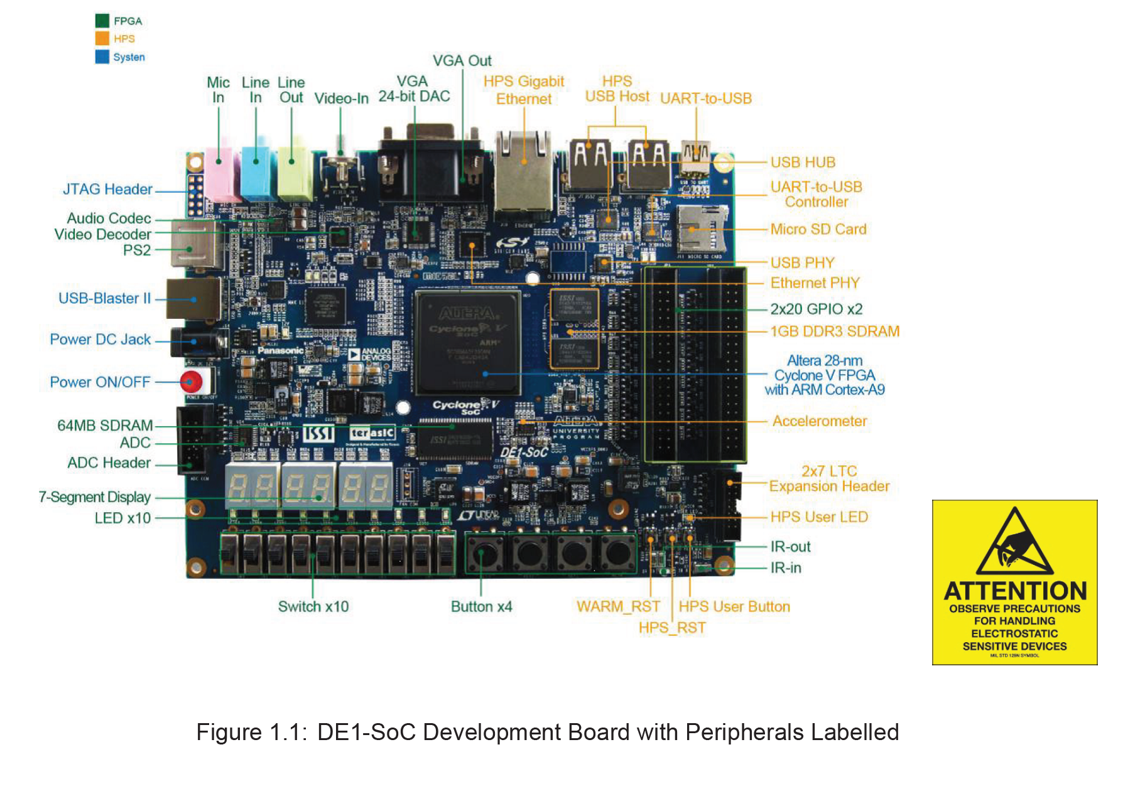
Terasic DE1-SoC
Notes:
Unlike simple MCUs, large scale CPUs and FPGAs typically come in packages with pin numbers that range from hundreds to several thousand, and frequently come in ball-grid array style packages. FPGAs and SoC devices also typically require carefully designed power supplies with multiple carefully regulated voltages. Together, this makes early development with FPGAs challenging, and is why development kits such as this one are vital at the early design stages

Slide 27

Terasic DE1-SoC
Notes:
Unlike simple MCUs, large scale CPUs and FPGAs typically come in packages with pin numbers that range from hundreds to several thousand, and frequently come in ball-grid array style packages. FPGAs and SoC devices also typically require carefully designed power supplies with multiple carefully regulated voltages. Together, this makes early development with FPGAs challenging, and is why development kits such as this one are vital at the early design stages

Slide 28

Electrostatic Sensitive Devices - Warning
The boards are expensive — they cost several hundred pounds so treat them with care, just as you would a shiny new phone or tablet. The electronics are very sensitive to static electricity.
Place the board inside the Anti-Static bag provided when not being used.
The Anti-Static (foil) bag is not rubbish — don’t throw it in the bin!
Do not touch the back of the boards — an Electro-Static Discharge (ESD) can destroy the FPGA in the blink of an eye with no obvious external signs of damage.
Do not apply power the boards while inside or on top of the ESD bags. ESD bags are electrically conductive, so can short out and damage powered boards.
Do not lose the MicroSD Card— if you lose it, you will not be able to load programs onto the board and will have to purchase a replacement 2GB MicroSD card.
You will also be receiving an LCD module, the Terasic LT24 module. The same rules about ESD sensitivity and Anti-Static bags apply to the display module as well.

Slide 29

Electrostatic Sensitive Devices - Warning
Image courtesy
https://www.protectiveindustrialpolymers.com/

Slide 30

Electrostatic Sensitive Devices - Warning
Image courtesy
https://www.weidinger.eu/en/i/esd-protection-zone-and-protective-measures

Slide 31
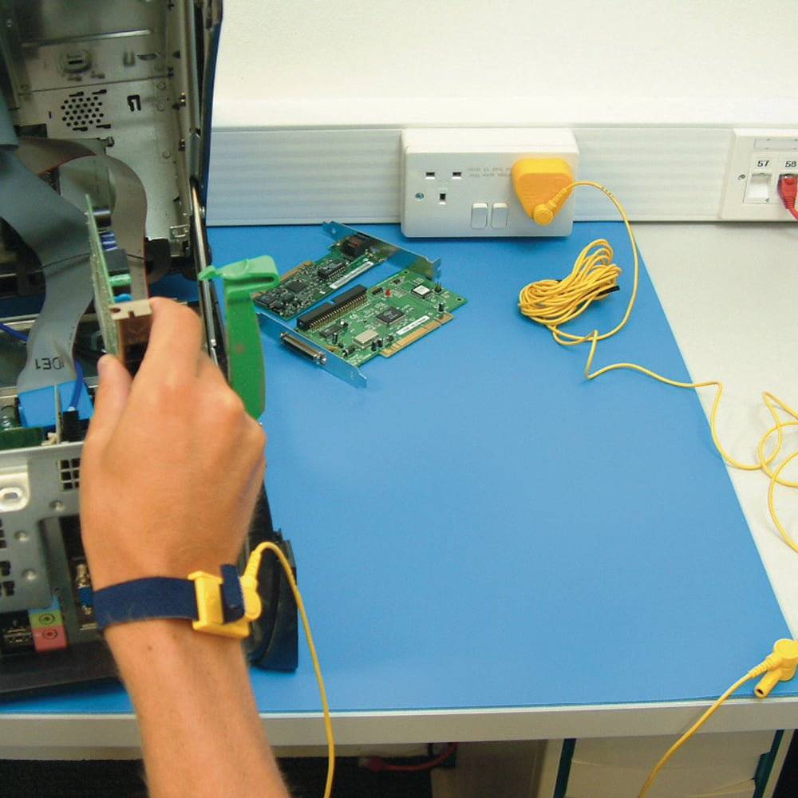
Electrostatic Sensitive Devices - Warning
Image courtesy
https://www.cobaeurope.com/esd-equipment/esd-matting-facts-7253

Slide 32
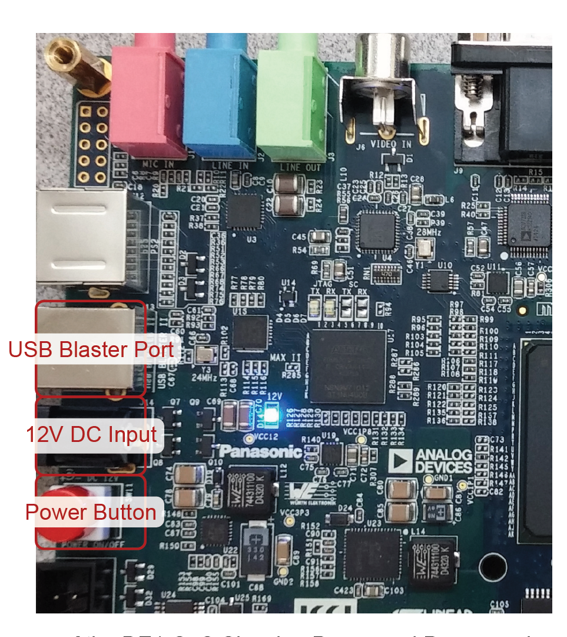
Powering on the DE1-SoC
To power on the board and enable it to be programmed
Make sure that:
The USB cable is connected between the USB port in the computer and the USB Blaster on the DE1-SoC dev board. Note: This is the type B USB port (J13).
Ensure the DE1-SoC dev board is plugged in to the 12V DC power supply.
Turn on the DE1-SoC board by pressing the red power button — the blue LED shows that the power is on.
When you have finished using your DE1-SoC, you must:
Turn the board off using the power switch.
Unplug the 12V power supply from the AC power supply.
Notes:
The DE1-SoC board is supplied with a 12V DC power supply, and a USB Type-B cable. In order to be able to program the ARM processor on the boards, we will make use of the USB Blaster port on the DE1-SoC device that acts as a basic JTAG (Joint Test Action Group) standard programmer used to program most SoC devices and many other devices as well. To power on the board and enable it to be programmed, a few connections need to be made as shown in Figure 1.2. Make sure that:

Slide 33
Testing the DE1-SoC
Once the board is powered - > FPGA will be configured using the Leeds SoC Computer firmware
Demo C program will begin running on the ARM processor:
University of Leeds 😁 on the 7-Segment displays and creating a pattern on the LEDs Change the pattern by playing with the toggle switches). Make sure the MicroSD card is in the slot in the top-right corner of the board!
Perform tests when you first receive the board to make sure it is working correctly:
Notes:
1.4 Documentation
Documentation for the DE1-SoC boards, including the full circuit schematic (for the curious amongst you) and the user manuals for the DE1-SoC board, are available to download from the learning resources section of Minerva.
The user manual provides useful information about the location of peripherals on the boards, the functionality of the various connectors, and information about the components used on the board. The documentation also contains pin-assignment information for peripherals. Datasheets for the LT24 display and SG-90 servo motor are also included in the learning resources section of Minerva.
Set all the switches to the off position (away from the LEDs), then from right-to-left put each switch in the on position one-by-one. You should see a different pattern being display on the LEDs.
Make sure that you can see all 10 patterns (to verify the switches work).
You should also make sure that all the LEDs and 7-Segment displays are working.
Finally, try pressing each of the four big buttons along with the HPS User Buttons (see figure 1.1) in turn. You should see the HPS User LED in the bottom right corner illuminate green when any of the buttons are pressed.

Slide 34
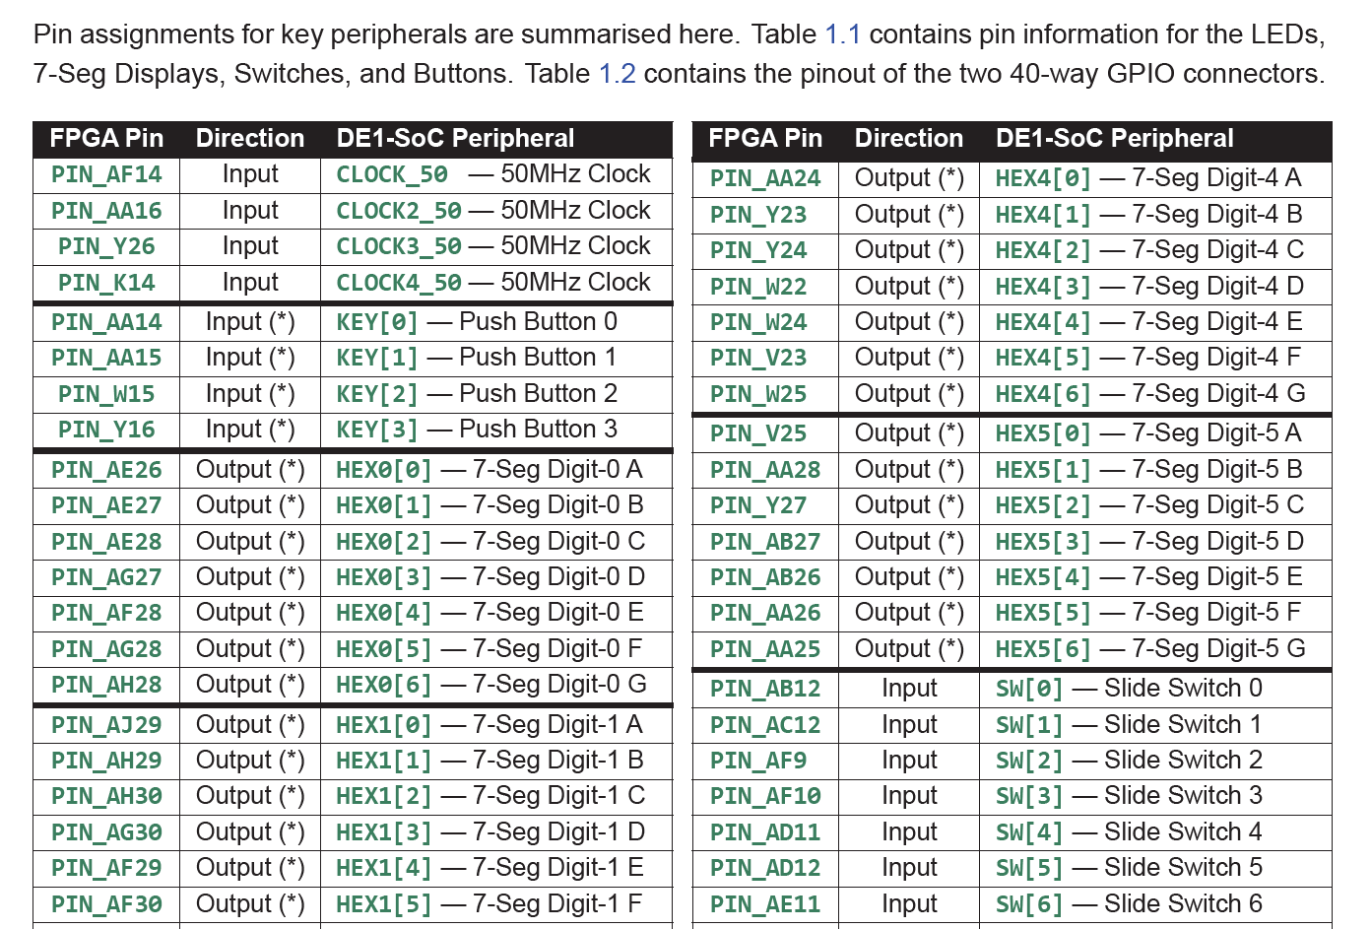
DE1-SoC Pin Assignment

Slide 35
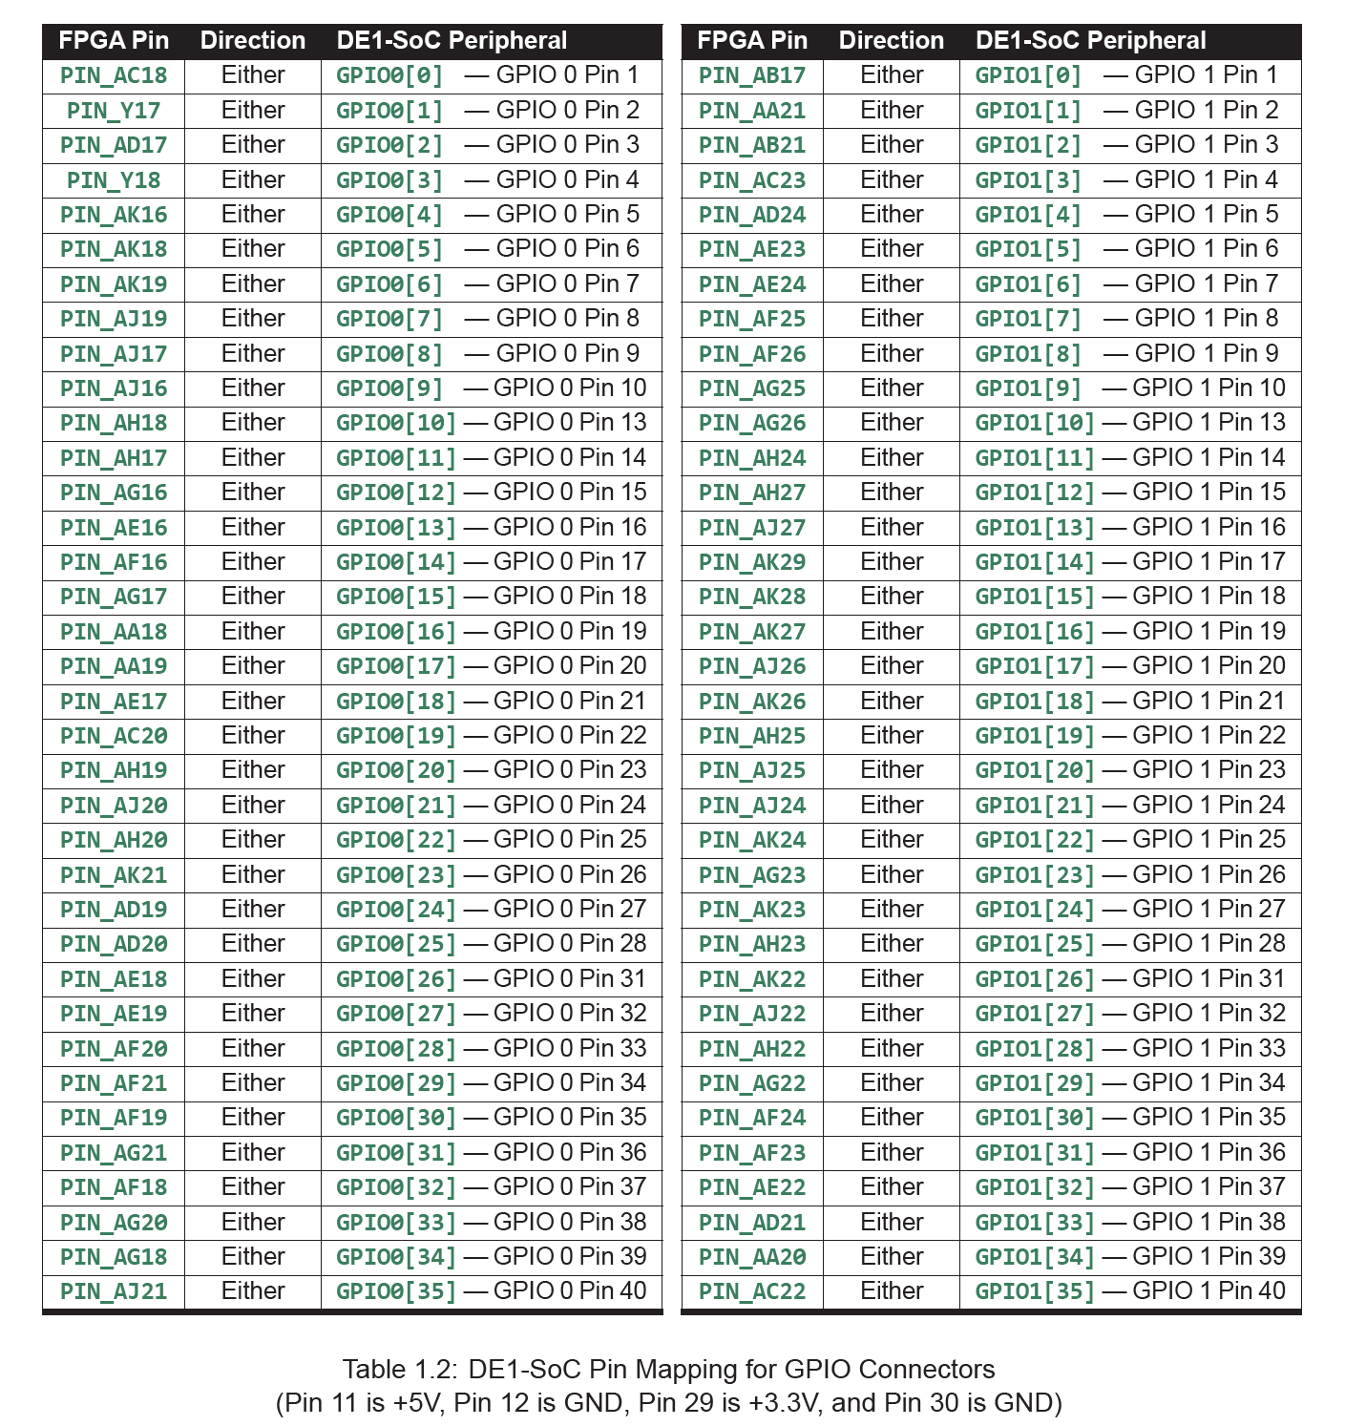
DE1-SoC Pin Mapping for GPIO Connectors
Notes:
When using the GPIO pins, it should be noted that they use a 3.3V logic level. This means that when configured as an output, the pins will output 3.3V to represent a logic high. The pins are 5V tolerant, which means they can be directly driven from a 5V signal.

Slide 36
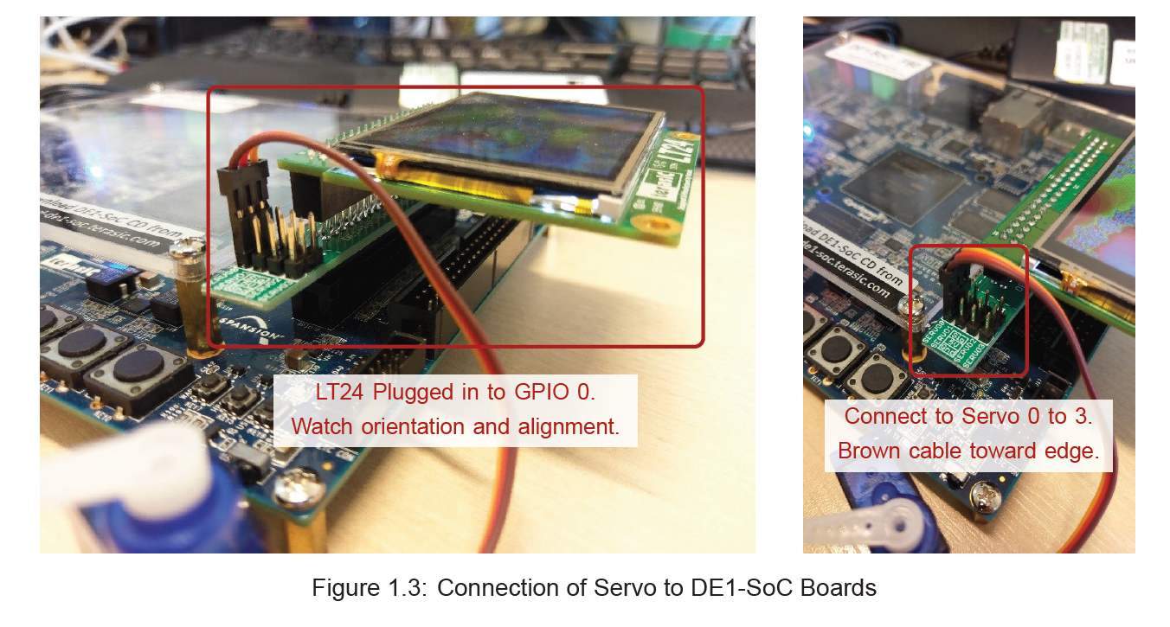
Connecting LCD and Servo
Notes:
The display is an LT24 LCD module made by Terasic. This connects to the DE1-SoC board using a 40-pin header. Additionally, an adapter board is provided, which breaks out the four unused GPIO pins in the header to four servo connectors. The Servo adapter board has been permanently glued to the LT24 module in the correct orientation, so do not try to separate them. While you won’t need them in this Lab session, it is useful to know how to safely connect them.
To connect the LCD and Servo adapter to the DE1-SoC, you should plug the 40-pin connector on the servo adapter board on to the GPIO0 connector of your DE1-SoC board. Do not use force when connecting the boards. Furthermore, make sure that all the pins are lined up (if you are not careful, you can plug the display in offset by one pin). Incorrect connection of the LT24 module may damage both the display and the DE1-SoC.
You can then connect the SG-90 digital servomotor to the four servo connectors, labelled SERVO0to SERVO3. When connecting the servo, the orange cable should be closest to the LCD, and the brown or black cable away from the LCD as pictured in Figure 1.3. When using the LCD or Servos, make sure the connections are as shown before powering on the DE1-SoC. Do not plug in the LCD or other hardware with the board powered on.
The pin assignments for the LCD module will be covered in the next lab. For the four servo headers, you should use the pin assignments shown in Table 1.3. You can either use an outputtype pin if you want the servo to always be enabled, or use an inouttype pin if you want to be able to disable (tristate) the servo.
These pins can optionally also be used as general-purpose inputs or outputs. When being used for GPIO other than servos, note that the pinout of the servo connectors is marked on the breakout PCB.

Slide 37
Compilation for Hardware
Fitter (Place & Route): The fitter step takes the RTL netlist generated during synthesis and maps it on to physical resources within the FPGA. It will then make all the connections (routing) between the resources to implement your circuit. It is at this stage that if you were not careful with your Verilog code, you may get errors such as using multiple clocks for the same register.
•Assembler: The purpose of the assembler is to generate a programming file called an SRAM Object File (.sof) which can be used to program the SRAM within the FPGA.
•TimeQuest Timing Analysis: This step will perform timing analysis to check for any synchronous circuits that are clocked faster than the FPGA can handle. The SDC file is used to specify the clock frequencies within the design as well as required timing constraints.
Notes:
As you may recall, you were instructed to install two task flows for Quartus at the start of the module. Up until now you have only been using the UoL Simulation Compileflow. For hardware compilation, we will need to instead use the UoL Board Compileflow. This flow includes additional steps to compile the design through to a programming file. The following additional steps are performed when compiling for hardware.
…Slide…
As discussed in the previous set of notes, the concepts of timing analysis are quite complex and will and there is insufficient time during this module to cover this step. For most designs, we will be running the FPGA at quite a low clock frequency (50MHz), so you should not come across any timing issues (unless you start using multiple clocks in your design — don’t!). Modifying designs that don’t meet timing is somewhat of a dark art and requires a great deal of patience.
2.1.2 Synchronous Logic Designs
To test synchronous designs, you can use one of the CLOCK_50signals as listed in the pin assignments table. These four pins provide a 50MHz clock signals. You should use this 50MHz clock for all your synchronous designs, which will connected via an inputport in your top-level module.
10 ELEC5566M: FPGA Design for System on Chip Unit 3.1: FPGA Hardware Part 2: Compilation for Hardware
When compiling synchronous designs, it is important to include the Design Constraints (SDC) file. This file specifies amongst other things the frequency of the clock and the port in your design that is the clock signal. You have been given a sample SDC file in the example projects, and you may continue to use this sample file. When using the 50MHz clock input, a create_clockcommand should be added to your SDC file in the section of the file commented as # Create Clock. The structure of the command is as follows, simply replace clockPortNamewith the name of the port in your top level module.create_clock-nameclock50-period"50MHz"[get_portsclockPortName]

Slide 38
Pin Assignments
There are four ways of making pin assignments in Quartus:
Graphically: This is done using the Pin Planner
Assignment Editor: Entering assignments directly using the Assignment Editor
Script Based: Using a TCL Script to make the assignments.
Top-Level Module Verilog File: Using the Verilog Attributes syntax, assignments can be specified in your Top-Level Verilog file.

Slide 39
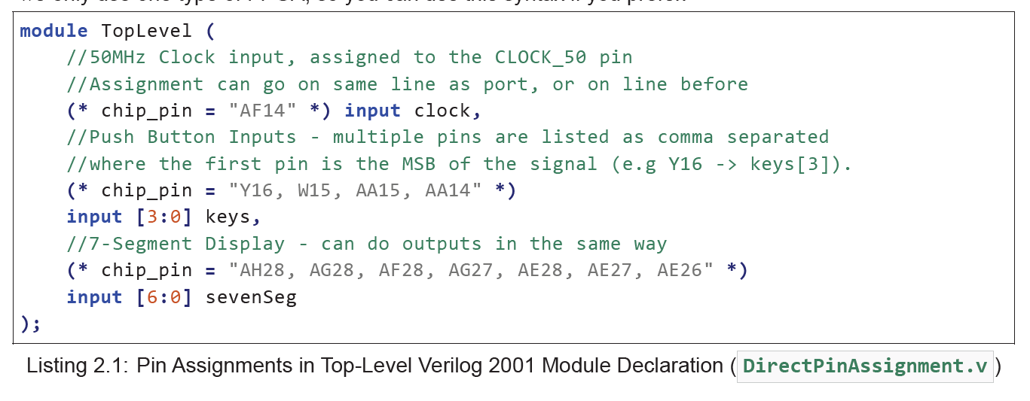
Pin Assignments – Top Level Module Declaration
Notes:
For completeness, Listing 2.1shows an example of how pin assignments can be made in the top-level Verilog file. While this approach reduces the number of steps, and allows you to clearly see in the design file which pin is connected where, the approach limits the Verilog file to being used with one specific FPGA package, as the pinout for a different FPGA would require changing the assignments. In these lab sessions we only use one type of FPGA, so you can use this syntax if you prefer.

Slide 40
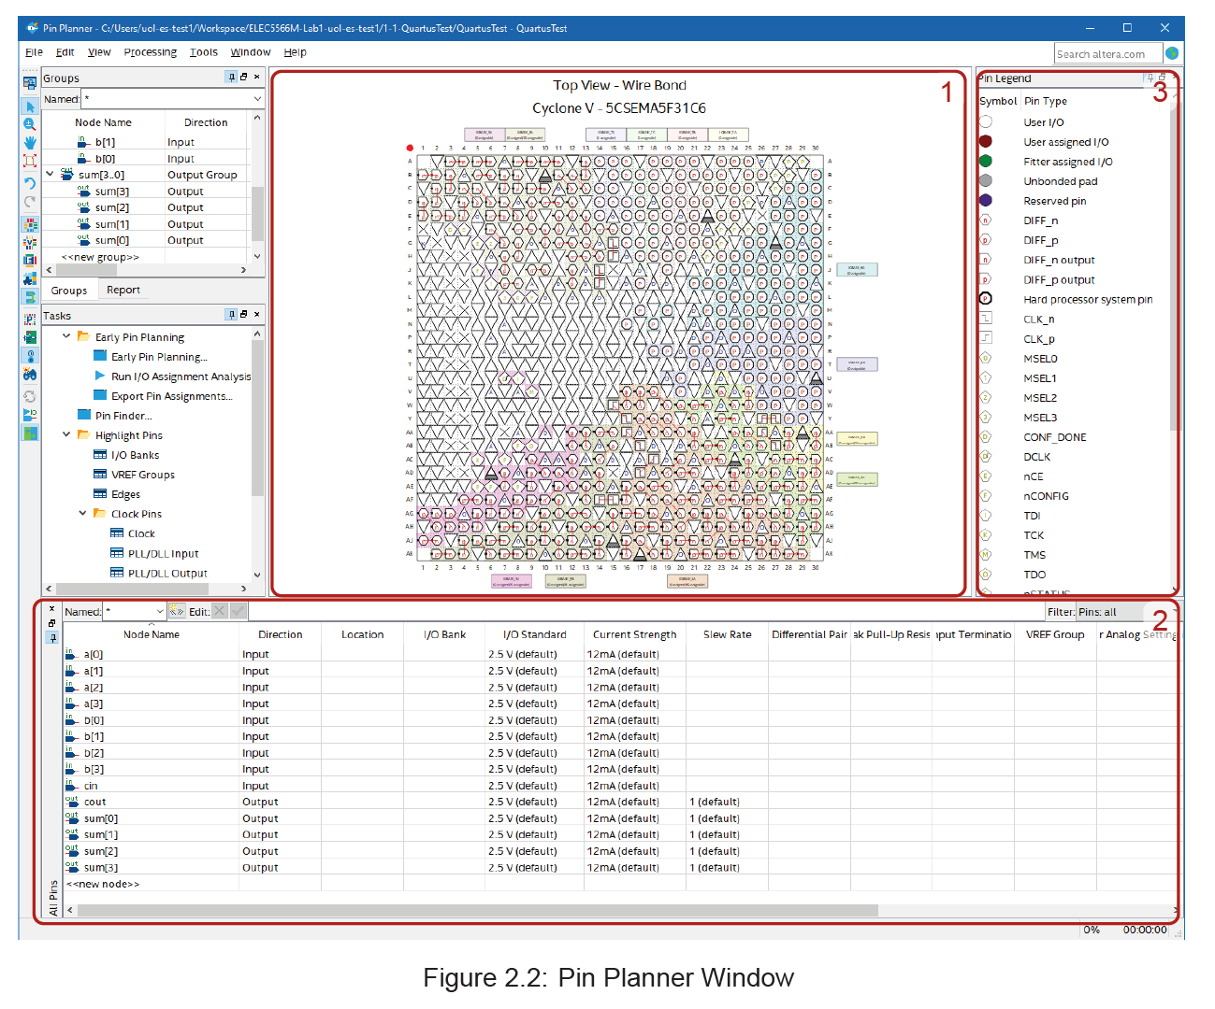
Pin Planner Window
FPGA View: Physical pins on the FPGA, their function and if they’ve been assigned to a pin in your design.
All Pins View: Contains a full list of the user IO pins in your design.
Pin Legend: Describes what each symbol in the FPGA View represents. Some pins have special features such as power and configuration which cannot be assigned for general purpose IO.
Notes:
Before we can make assignments in the Pin Planner, we must first run Analysis & Synthesison the design. This step is required to allow Quartus to detect the pins in our top-level module and populate them in the Pin Planner.
Run only the Analysis & Synthesis step by double-clicking on it the Tasks pane.
Make sure the step completes successfully.
Open the pin-planner window by double-clicking Edit Pin Assignmentsin the task flow pane as shown in Figure 2.1.

Slide 41
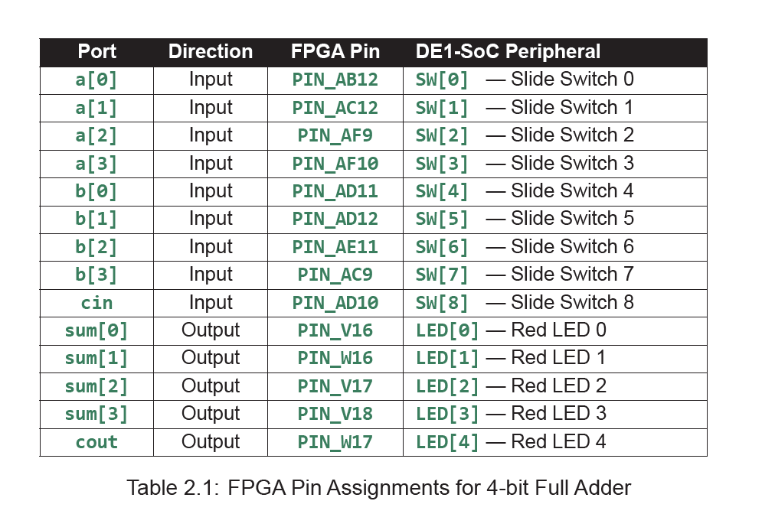
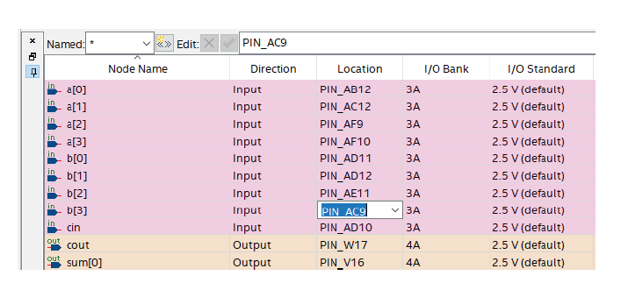
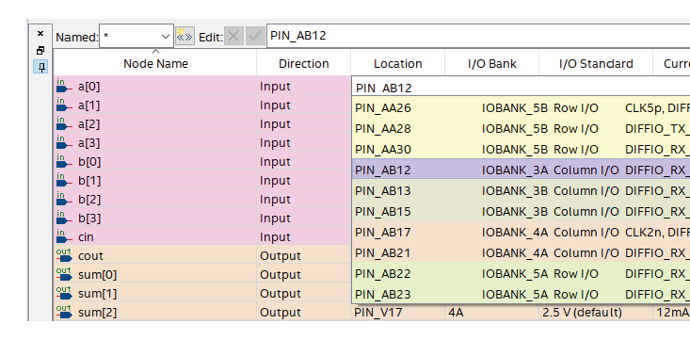
Pin Assignment Example – 4-bit Adder

Slide 42
Assign Pins Carefully!
It is vitally important to make sure your pin assignments are accurate.
If for example you accidentally assign an output pin in your design to an input pin on the DE1-SoC board, it will damage the FPGA. Furthermore, do not leave any pin in your design unassigned. Any pins without a pin assignment will be automatically given a random pin number by the Fitter, which could unintentionally damage part of the FPGA board.
Any unused pin on the FPGA (i.e. FPGA pins that you do not assign to pins in your design) will default to inputs with a weak pull-up resistor. You might see that unused LEDs on the DE1-SoC board dimly glow because of these pull-up resistors. You do not need to worry about this, it is quite normal.

Slide 43
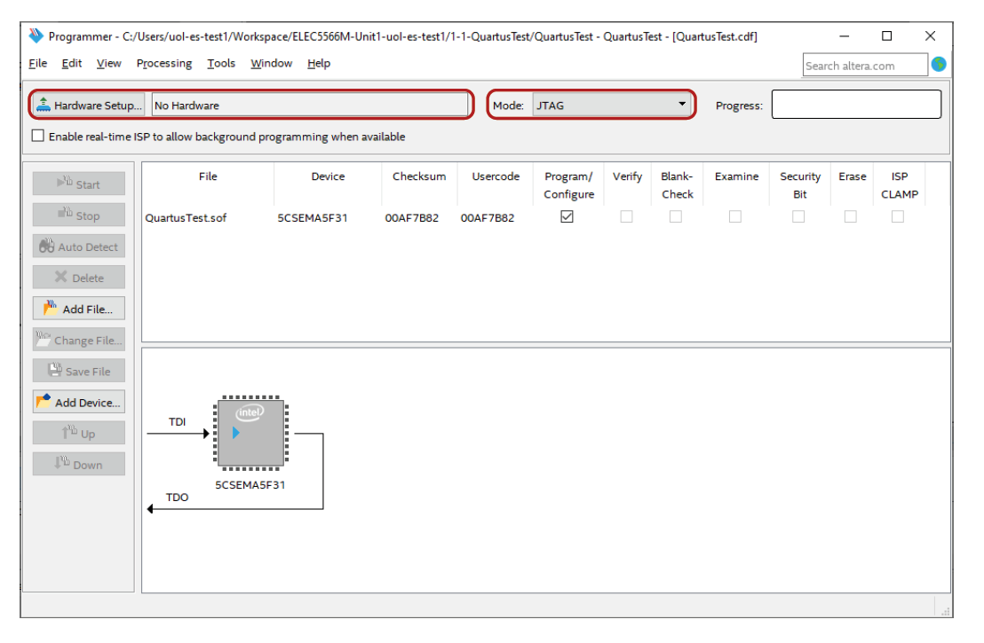
Quartus Programmer
Notes:
For this module, you will not be writing to the flash memory (please don’t even try!). Instead, you will be programming the FPGA directly using the SRAM Object File created by Quartus. Once programmed, your design will temporarily replace the default design in the FPGA and immediately start running. When you disconnect the power, your design will be forgotten and the default design loaded next time power is applied.
To program the board, we need to first launch the programmer:
Double-click on Program Device (Open Programmer)in the Tasks windowYou should make sure a project is loaded before launching the programmer.
The programmer window will open, and you will see a screen similar to the screenshot in Figure 2.7.
Make sure that the Mode:drop-down menu in is set to JTAG — this should be the default setting.

Slide 44
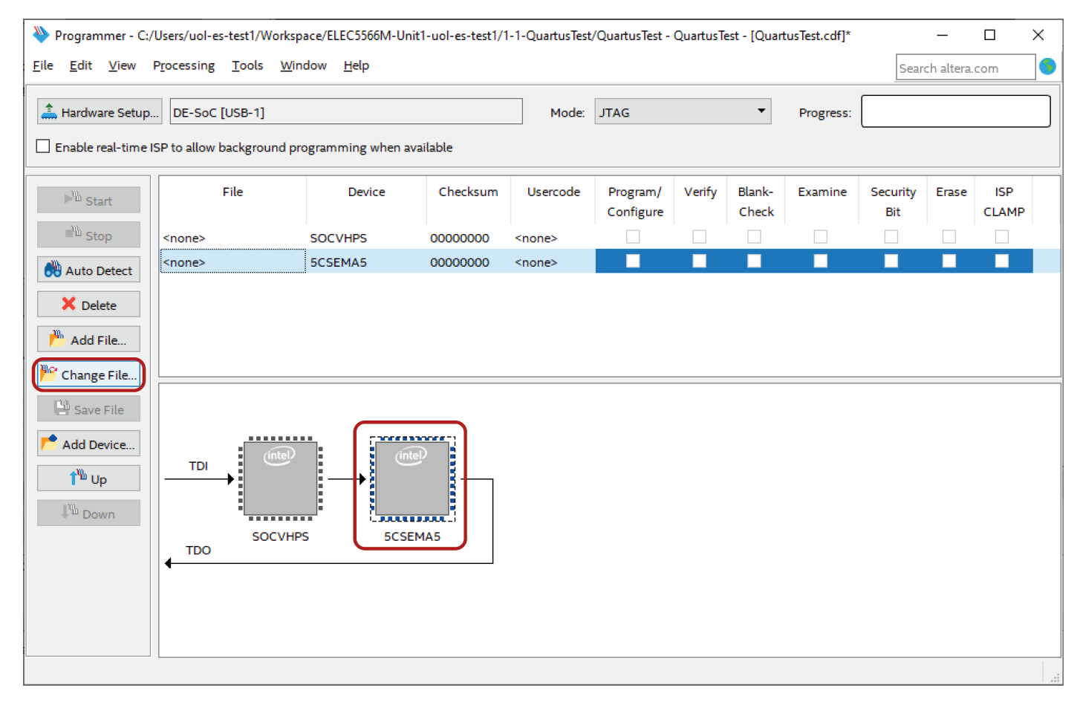
Programming Chain

Slide 45
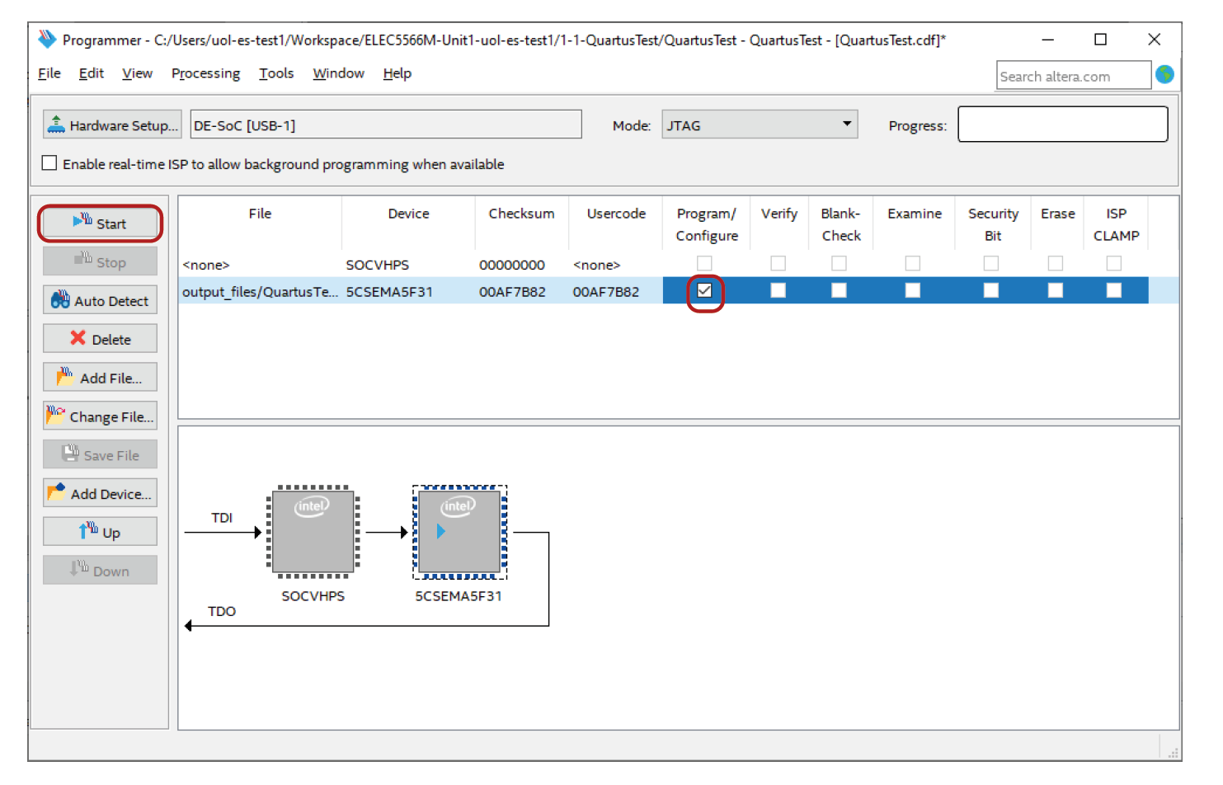
Programming the FPGA
Notes:
Take care with pin assignments!.
Keep your code simple. Test it works before uploading to hardware
Carry out the tasks. If too complicated - simplify before building up. E.g. half adder

Slide 46
Questions?

Slide 47
Number Systems

Slide 48
Typical Datatypes
TYPE | BITS | REPRESENTATION
char | 8 | ASCII
short | 16 | Binary, 2’s Compliment
int | 32 | Binary, 2’s Compliment
float | 32 | IEEE 32-bit
double | 64 | IEEE 64-bit
pointers | 32 | Binary (For addressing, span → 2³² addresses)
FPGA is not restricted to compiler or Processor datatypes.
12, 14, 18 or 24 bit ADCs and DACs 15 bit High Colour 18 or 24 bit RGB
Internal memory is valuable – only store additional bits when unavoidable.

Slide 49
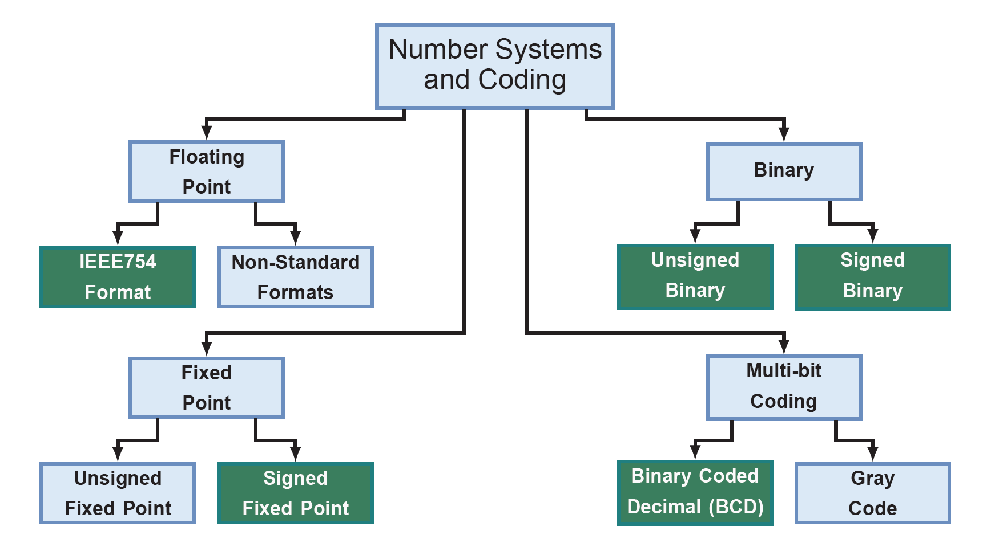
Number Representation
Notes:
Some of the most commonly used coding schemes are shown grouped into four related types. The most commonly used schemes are highlighted in purple. Each of the three main families in the chart provides a different engineering trade-off. We will discuss each of these in this lab, and perform some exercises to allow you to become familiar with their use.

Slide 50
Number System Examples
Raw Bits | Unsigned Integer | Two's complement | One's Complement | Sign and Magnitude | Two's Complement Fractional
1110 | 14₁₀ | -2₁₀ | -1₁₀ | -6₁₀ | -0.250₁₀

Slide 51
Number Representation
b₃b₂b₁b₀ | Unsigned | Sign and Magnitude | 1’s Complement | 2’s Complement | Binary Coded Decimal
0111 | 7 | +7 | +7 | +7 | 7
0110 | 6 | +6 | +6 | +6 | 6
0101 | 5 | +5 | +5 | +5 | 5
0100 | 4 | +4 | +4 | +4 | 4
0011 | 3 | +3 | +3 | +3 | 3
0010 | 2 | +2 | +2 | +2 | 2
0001 | 1 | +1 | +1 | +1 | 1
0000 | 0 | 0 | +0 | +0 | 0
1000 | 8 | -0 | -7 | -8 | 8
1001 | 9 | -1 | -6 | -7 | 9
1010 | 10 | -2 | -5 | -6 | Undefined
1011 | 11 | -3 | -4 | -5 | Undefined
1100 | 12 | -4 | -3 | -4 | Undefined
1101 | 13 | -5 | -2 | -3 | Undefined
1110 | 14 | -6 | -1 | -2 | Undefined
1111 | 15 | -7 | -0 | -1 | Undefined

Slide 52
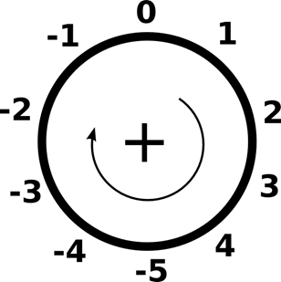
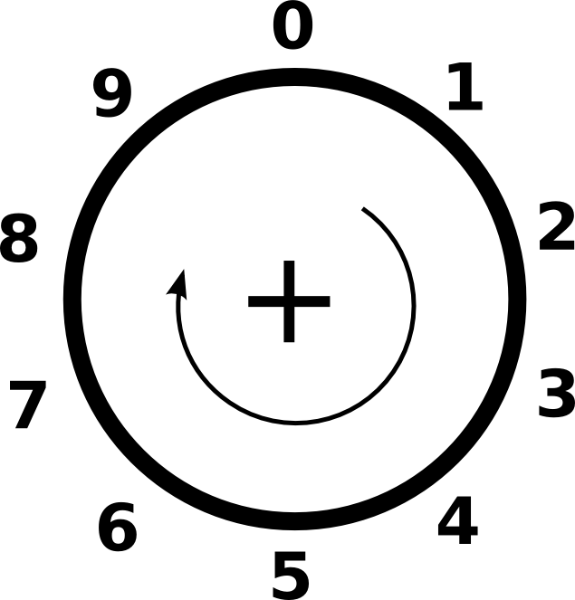
Unsigned Versus Two’s Complement Representation
2’s Complement (mod-10)
Unsigned (mod-10)

Slide 53
Unsigned Versus Two’s Complement Representation
2’s Complement (mod-10)
Unsigned (mod-10)
4 subtract 2 = -2 add 4
Complement of ‘-2’ is 10-2=8
4 - 2 = (-2) + 4 = (8 + 4) mod-10 = 2

Slide 54
Two’s Complement Subtraction
For subtraction, take the 2’s Complement and Add.
Subtraction become addition!
In 4-bit binary i.e. mod-16
(+4) 0100 (+4) 0100
-(+2) +0010 +(-2) +1110
(+2) 10010
Ignore carry digits shown in red

Slide 55
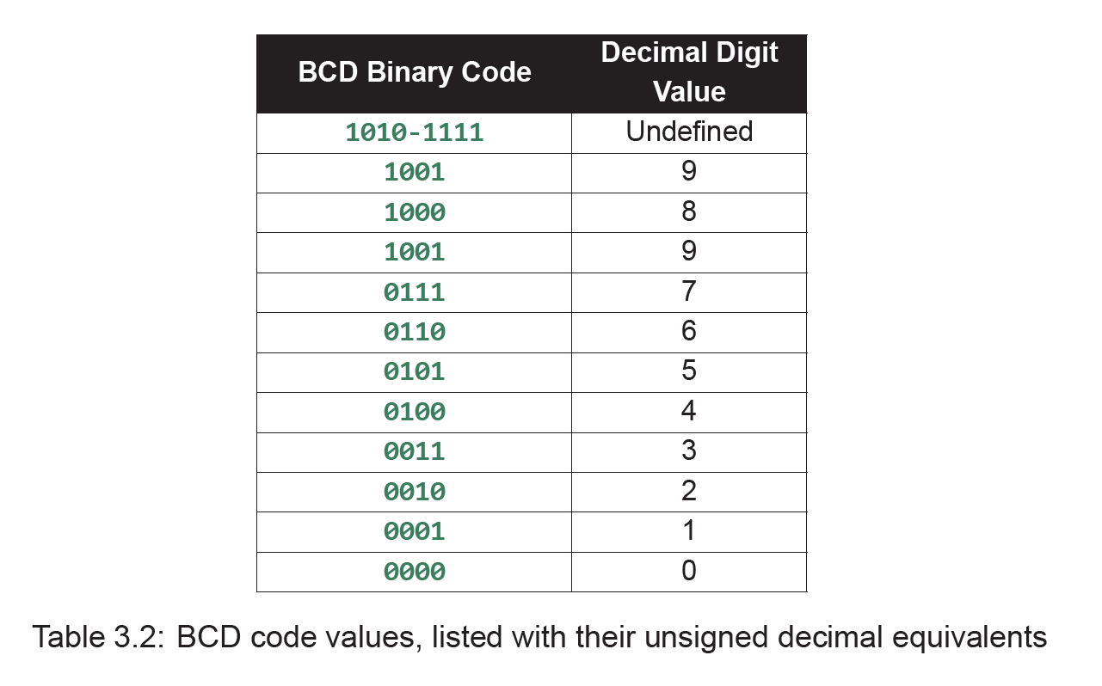
Integer to BCD Conversion
9₁₀ => 1001_{BCD}
10₁₀ => 10₁₀ + 6₁₀ = 1 0000_{BCD}
Take this example:
9₁₀ + 5₁₀ = 14₁₀
1001₂ + 0101₂ = 1110₂
For a single 4-bit input: add 6 if 10 or greater
1110₂ = 0000 1110₂ ₊ 0000 0110₂ = 0001 0100 _{BCD =} 14₁₀

Slide 56
Binary Coded Decimal Shift-and-add-3
100’s 10’s 1’s Original
0000 0000 0000 10110100 Initialization
0000 0000 0001 0110100 s=1
0000 0000 0010 110100 s=2
0000 0000 0101 10100 s=3 (add 3 to 1’s) 0000 0000 1000 10100 Add 3 if 5 or greater
0000 0001 0001 0100 s=4
0000 0010 0010 100 s=5
0000 0100 0101 00 s=6 (add 3 to 1’s) 0000 0100 1000 00
0000 1001 0000 0 s=7 (add 3 to 10’s) 0000 1100 0000 0
0001 1000 0000 s=8
1 8 0

Slide 57
Binary Coded Decimal Shift-and-minus-3
100’s 10’s 1’s Original
1 8 0
0001 1000 0000 Initialisation
0000 1100 0000 0 s=1
0000 1001 0000 0 Minus 3 if 8 or greater
0000 0100 1000 00 s=2
0000 0100 0101 00 Minus 3 from 10’s
0000 0010 0010 100 s=3
0000 0001 0001 0100 s=4
0000 0000 1000 10100 s=5
0000 0000 0101 10100 Minus 3 from 1’s
0000 0000 0010 110100 s=6
0000 0000 0001 0110100 s=7
0000 0000 0000 10110100 s=8 yields result

Slide 58
IEEE 754 Floating-Point Standard
Floating point representation consists of
sign(S), exponent(E), and significand (f).
more bits in significand gives more accuracy.
more bits in exponent increases range.
trade-off between accuracy and range !!!
32-bit float 1-bit 8-bit 23-bit (bias = 127)
(–1)^{S} x (1+f) x 2^{E – bias}
1
01111110
10000000000000000000000
sign
exponent
significand

Slide 59
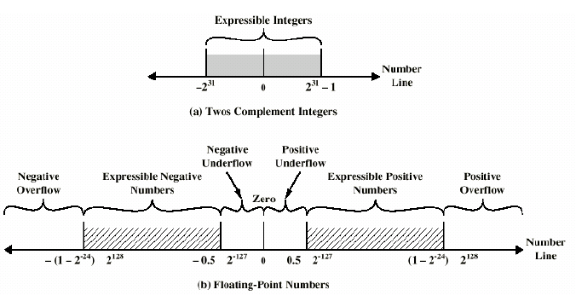
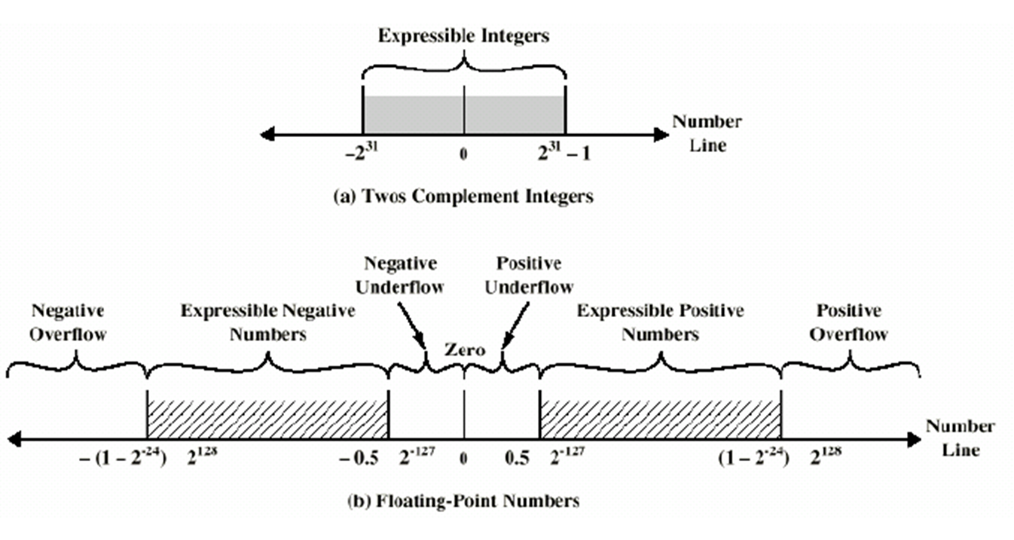
Expressible number range

Slide 60
Floating Point Numbers
We need to represent:
Real numbers e.g. 3.14159265…
Large numbers that cannot be represented with 32-bit integers, e.g. 3.15576×10⁹ (seconds in a century)
Very small numbers, e.g. 1.0×10⁻⁹
Single precision
Largest: 1.111…11 × 2²⁵⁴⁻¹²⁷ = (2-2⁻²³) × 2¹²⁷ ≈ 2¹²⁸ ≈ 3.4 × 10³⁸
Smallest: 1.00…0 × 2¹⁻¹²⁷ = 2⁻¹²⁶ ≈ 1.18 × 10⁻³⁸
Double precision
Largest: 1.111…11 × 2²⁰⁴⁷⁻¹⁰²³ = (2-2⁻⁵²) × 2¹⁰²⁴ ≈ 2¹⁰²⁴ ≈ 1.8 × 10³⁰⁸
Smallest: 1.00…0 × 2¹⁻¹⁰²³ = 2⁻¹⁰²² ≈ 2.2 × 10³⁰⁸

Slide 61
Hungarian Notation
Variable Name Prefix | Number Representation
nb | Natural (ie unsigned) binary representation
tc | Two's Complement ( ie signed integers)
fxn | Fixed point number with n bits in the fractional part
tcfxn | Signed (two's complement) fixed point number with n bits in the fractional part
flag | Simple 1 bit true or false flag bit
fp32 | 32 bit IEEE754 floating point number
fp64 | 64 bit IEEE754 floating point number

